Slide 1

Project 4 Group 3 Mitchell Lor Waynei Mebrahtu Eric Johnson Lucinda Hodgson
Predicting Corporate Credit Ratings
Data Source:
Kaggle
https://www.kaggle.com/datasets/kirtandelwadia/corporate-credit-rating-with-financial-ratios

Slide 2
Corporate Credit Ratings
-issued by specialist agencies
-provide an assessment about the credit worthiness of a company
-acts as a pivotal financial indication to potential investors
-opinion on the likelihood that a corporation will fully meet its financial obligations
Why is it important?
-corporate credit rating trends allow an investor to compare the credit worthiness
-provide investors with a concrete idea about the risk associated with the company’s credit investment returns

Slide 3

About the data
1377 unique corporations
7805 Rows
24 columns
First 9 are categorical
Next 15 are numeric

Slide 4
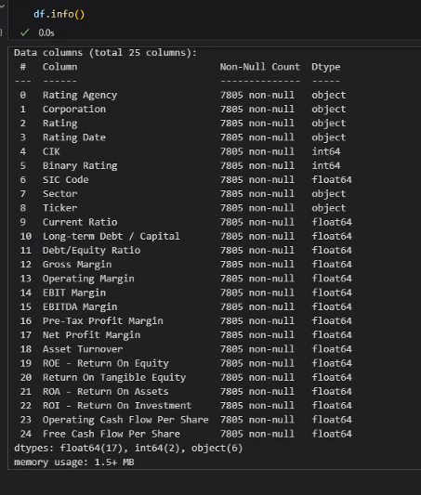
Columns:

Slide 5

Data Preparation
Loaded into database
Cleaned and processed data
Dropped unneeded columns
Corporation
Rating
CIK (Central Index Key)
Ticker
SIC Code (Standard Industrial Classification)
Rating Date
Examined data
Determined which metric held most weight

Slide 6

Binary Rating
original dataset for this credit rating project has undergone standardization,
all ratings were aligned with the S&P ratings including those from other agencies.
Binary Rating in this data set has been calculated to adhere to the industry-standard S&P Investment Grades and Junk Grades classifications

Slide 7
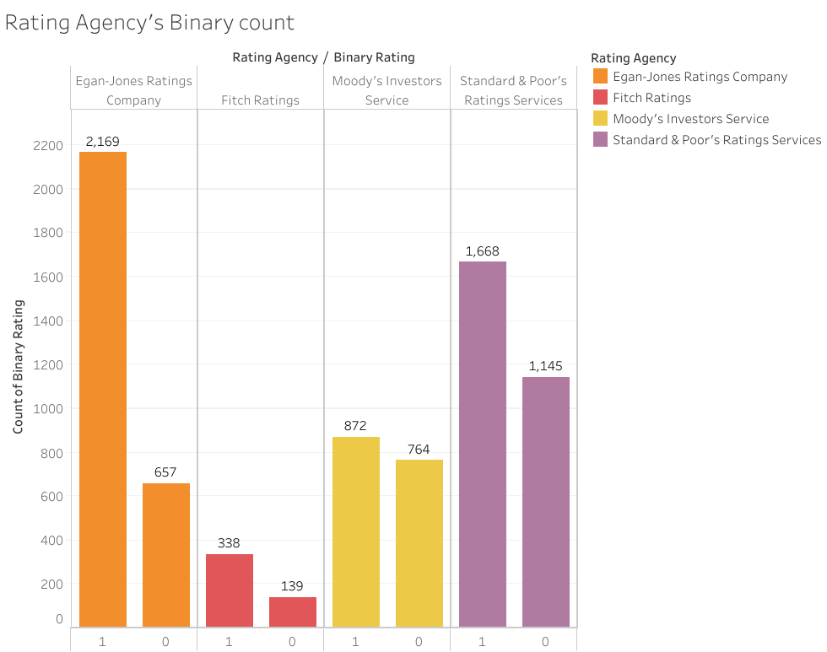
Establishing corporate credit ratings
Most of the specialist credit rating agencies have a unique discrete ordinal rating scale

Slide 8
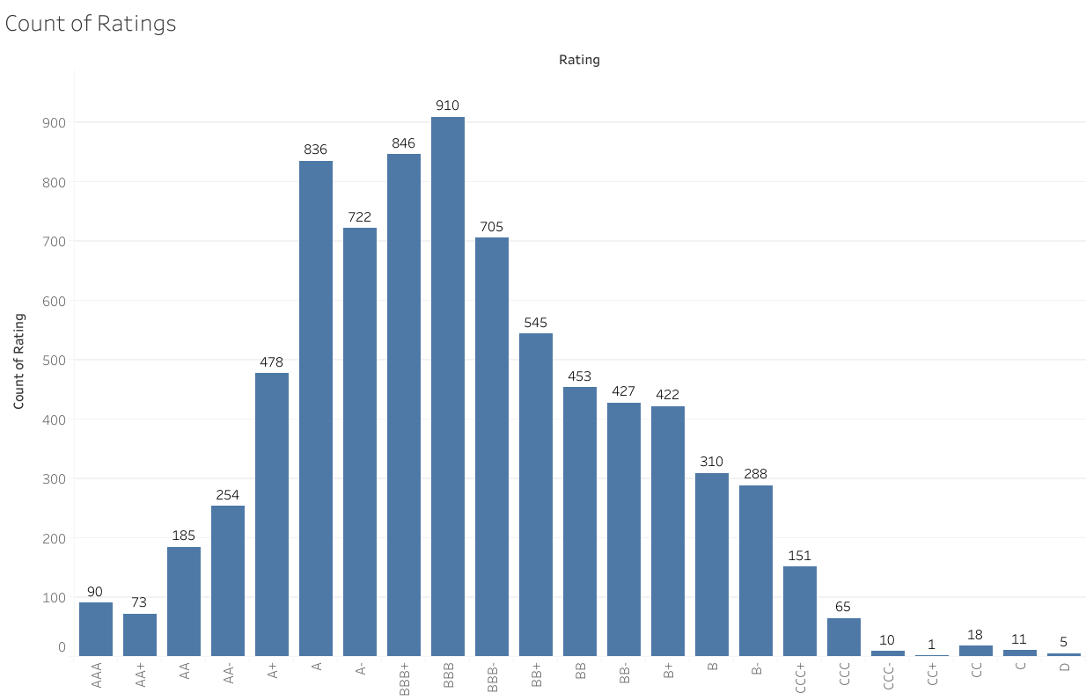
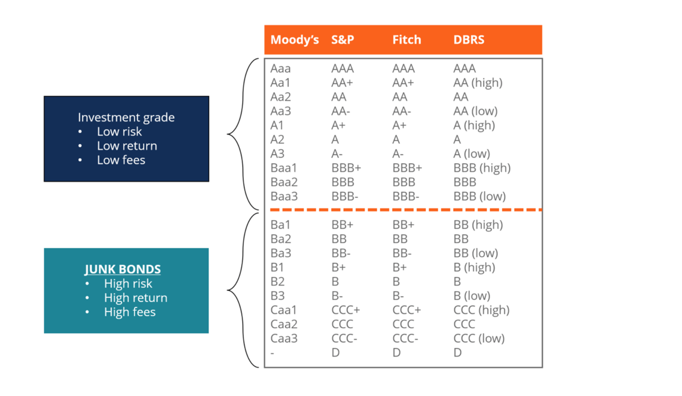
Ratings histogram:
Standard & Poor (S&P)broadly classifies the companies with rating higher than BB+ as investment grade companies and others as junk grade companies.
Notes:
What Is Standard & Poor's (S&P)?
Standard & Poor's (S&P) is a company well known around the world as a creator of financial market indices—widely used as investment benchmarks—a data source, and an issuer of credit ratings for companies and debt obligations. It's perhaps best-known for the popular and often-cited S&P 500 Index.

Slide 9
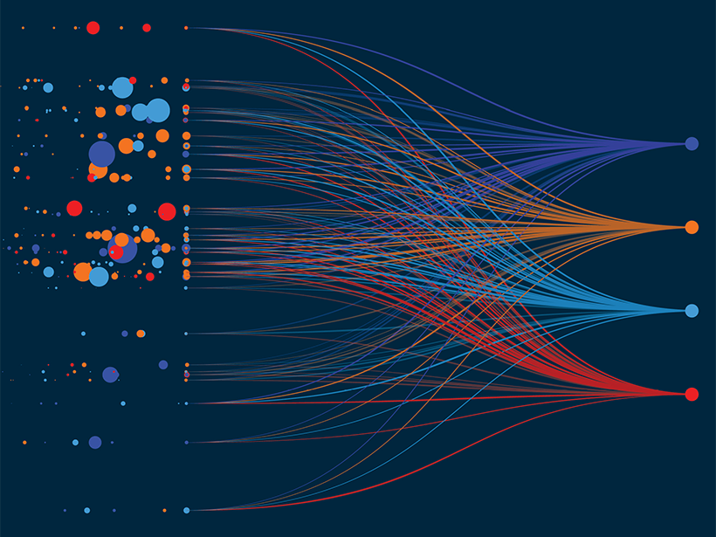
Deep learning/Neural Network
First tried deep learning
Hit roadblocks
Deep learning is for very large data sets and out data set did not meet that requirement
Moved on from this…

Slide 10
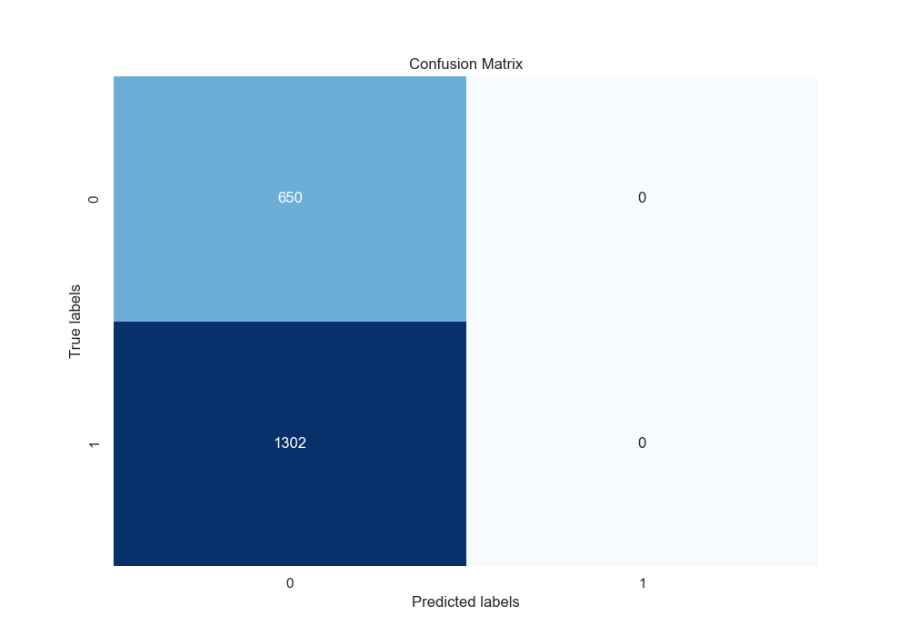
Confusion Matrix for Deep Learning/Neural Network Model 1

Slide 11
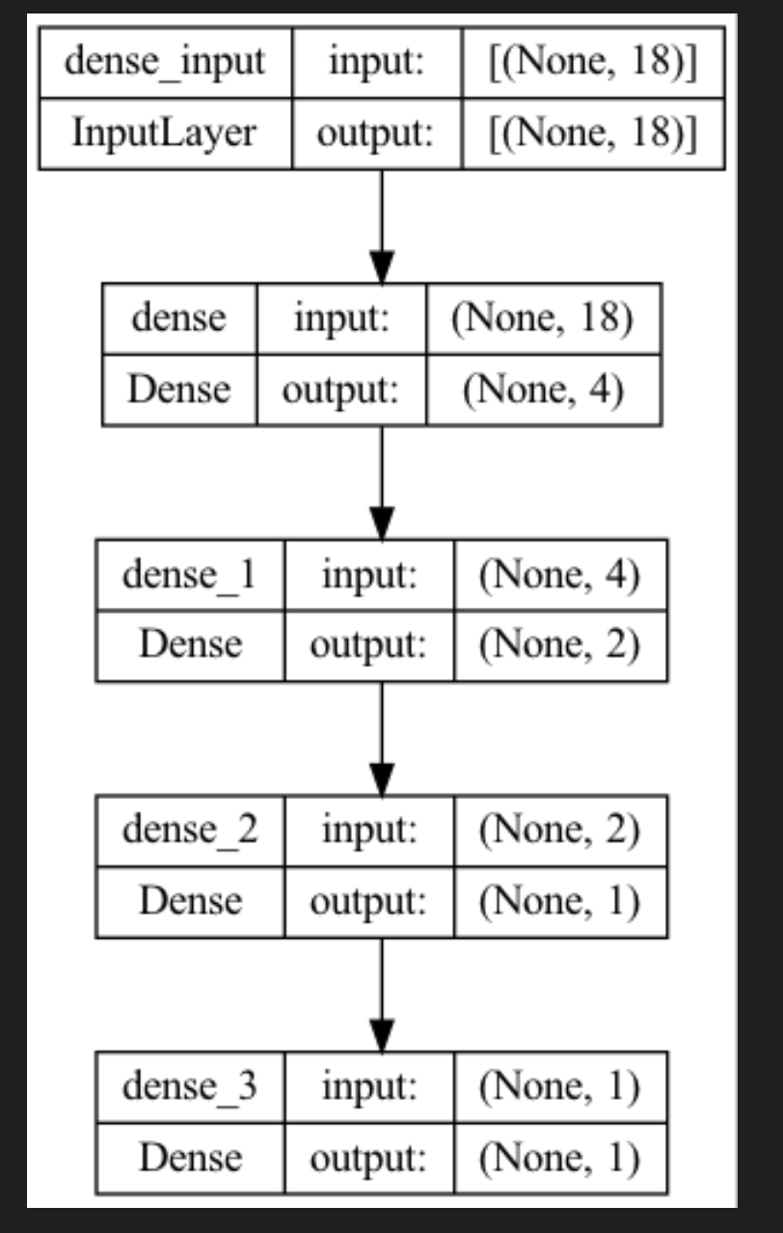
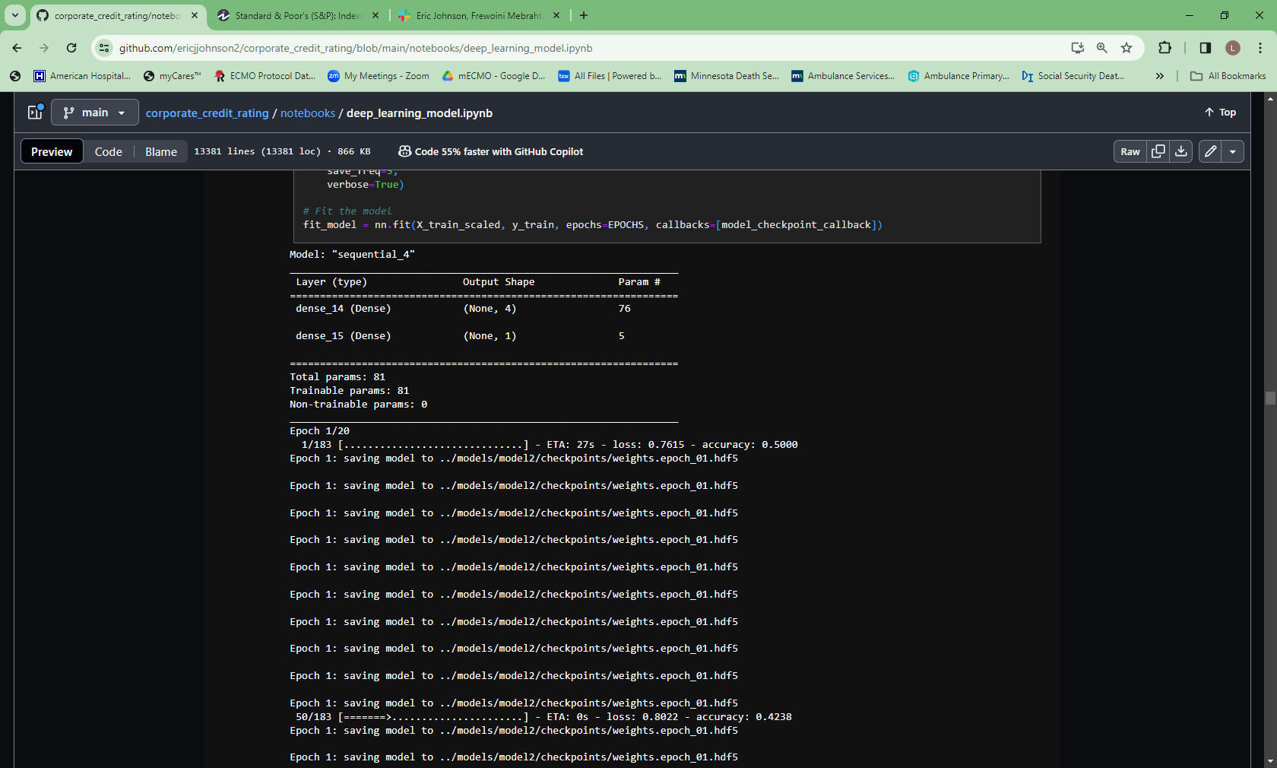
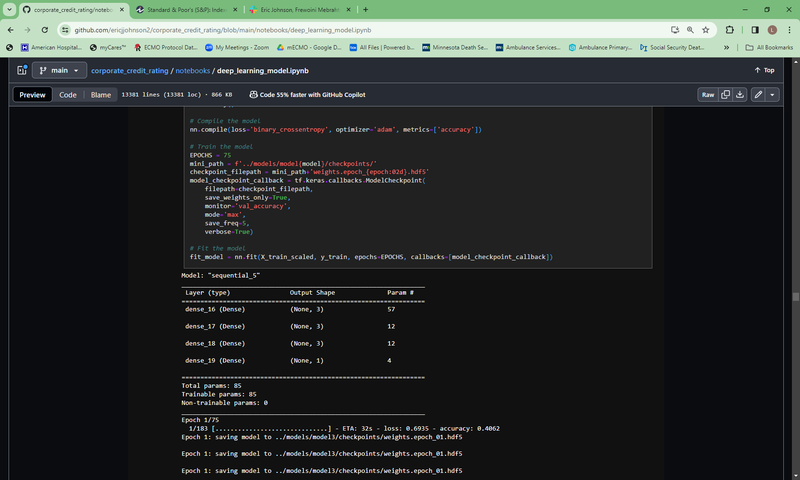
Deep learning/NN model 1: accuracy 52%

Slide 12
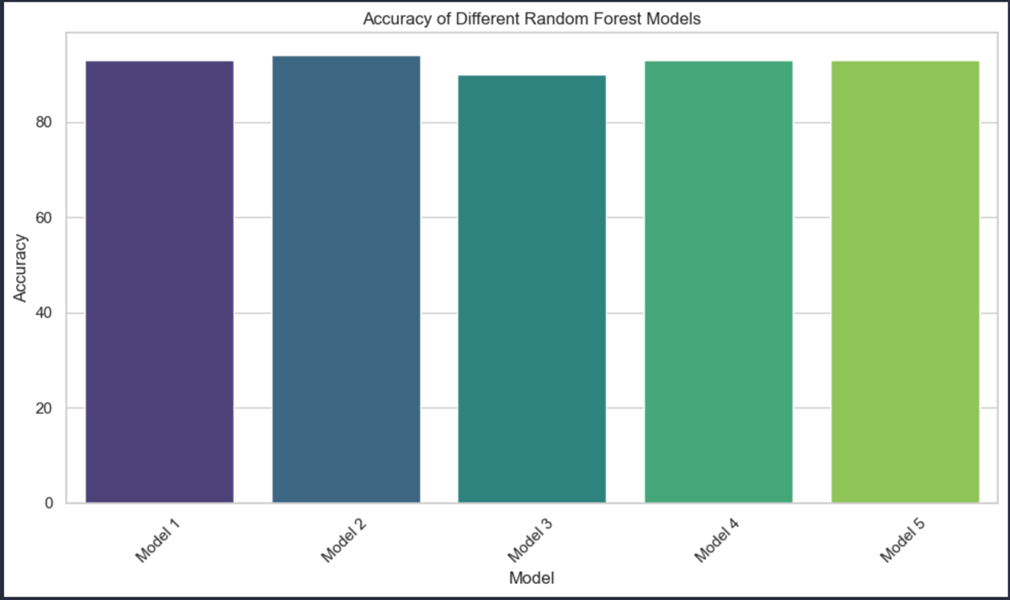
Random Forest
Tried RF next, worked with our data best
Increased accuracy
Ran 5 different RF models, all returned roughly 94%

Slide 13
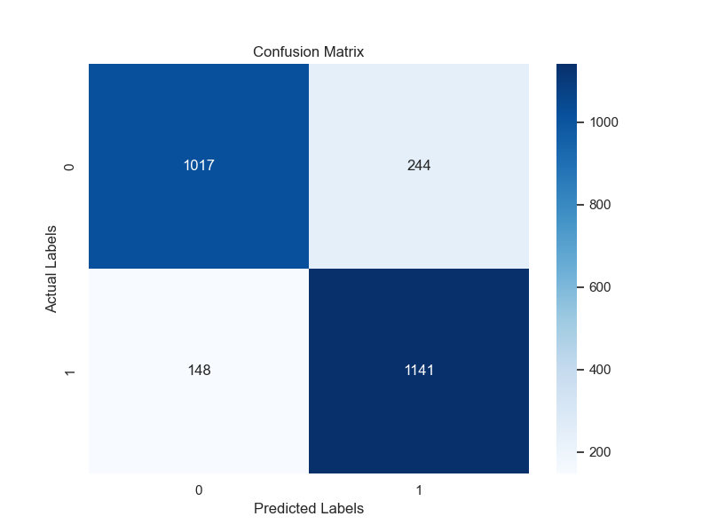
Confusion Matrix: accuracy score 0.94

Slide 14
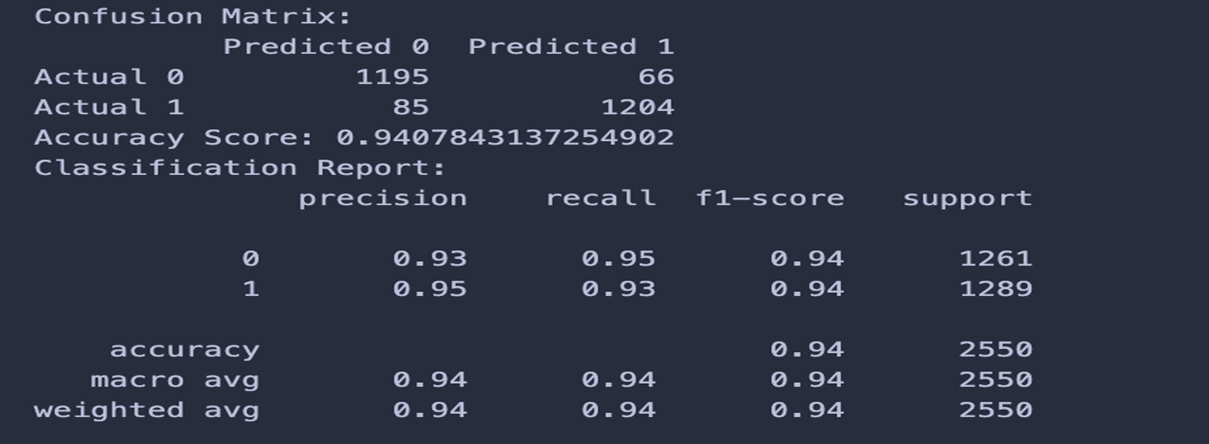

Slide 15
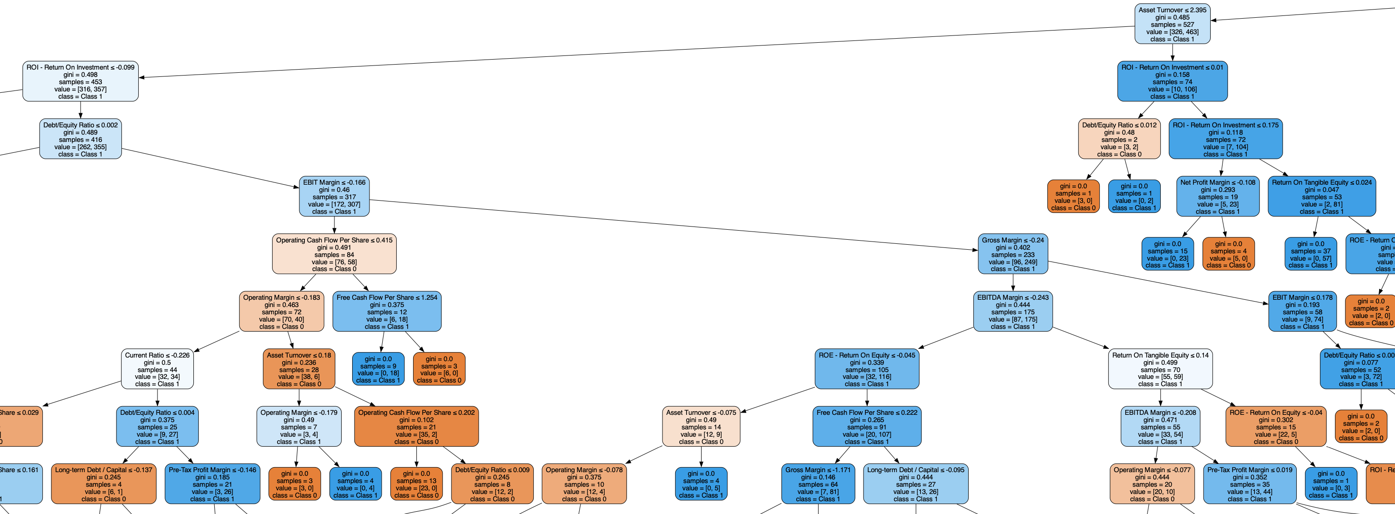

Slide 16
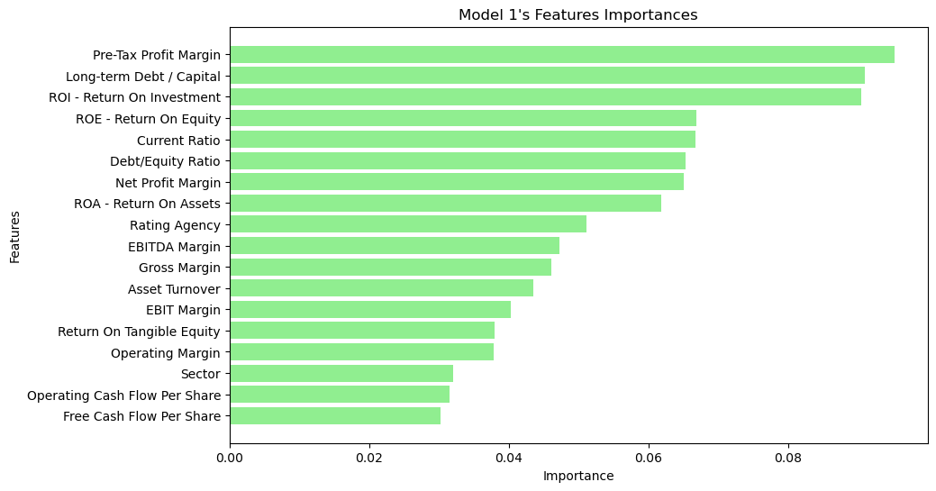
Feature Importance: Credit ratings are mostly determined by financial ratios coming from balance sheets, income statements, and cash-flow statements. In our winning model, the top three listed below were the most important features
Notes:
Intro:

Slide 17
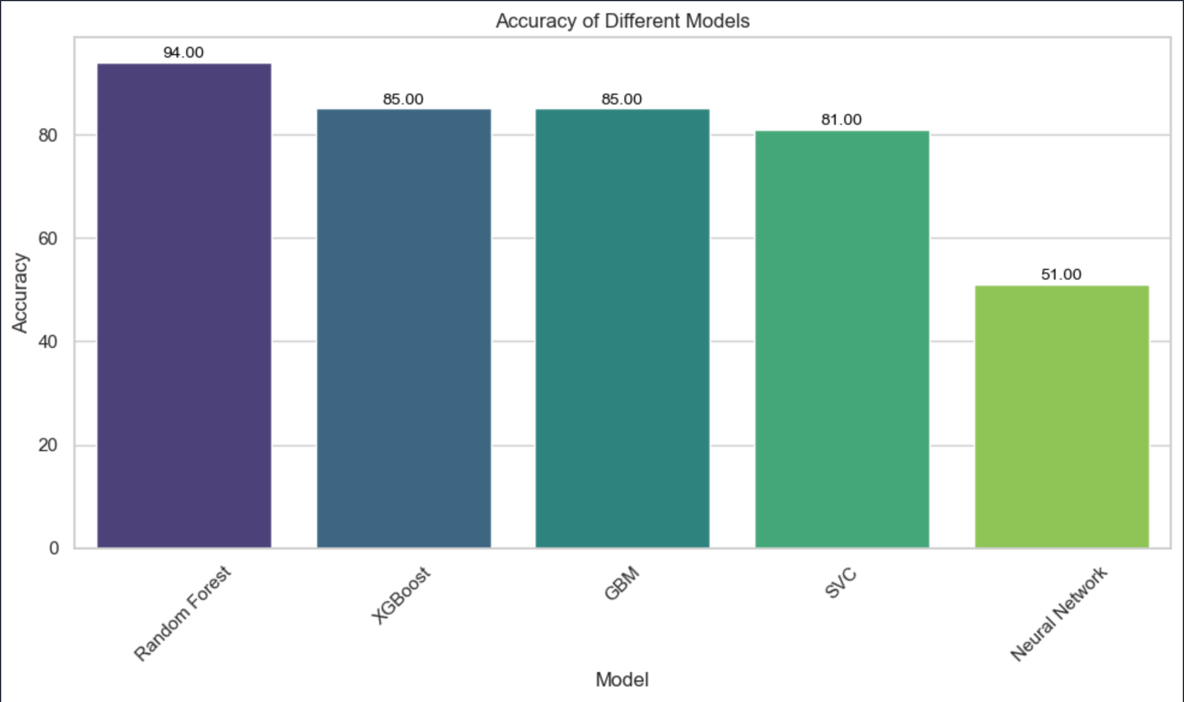
Trials, tribulations and limitations

Slide 18

Alpha Vantage API
Accessed live company data: Utilized the API to access live company data encompassing income statements, balance sheets, and cash flow statements.
Formatted data alignment: Formatted the retrieved data to align with the structure of our training data.
Graphical interface utilization: Employed a graphical interface to assess the real-time data against our trained model.

Slide 19
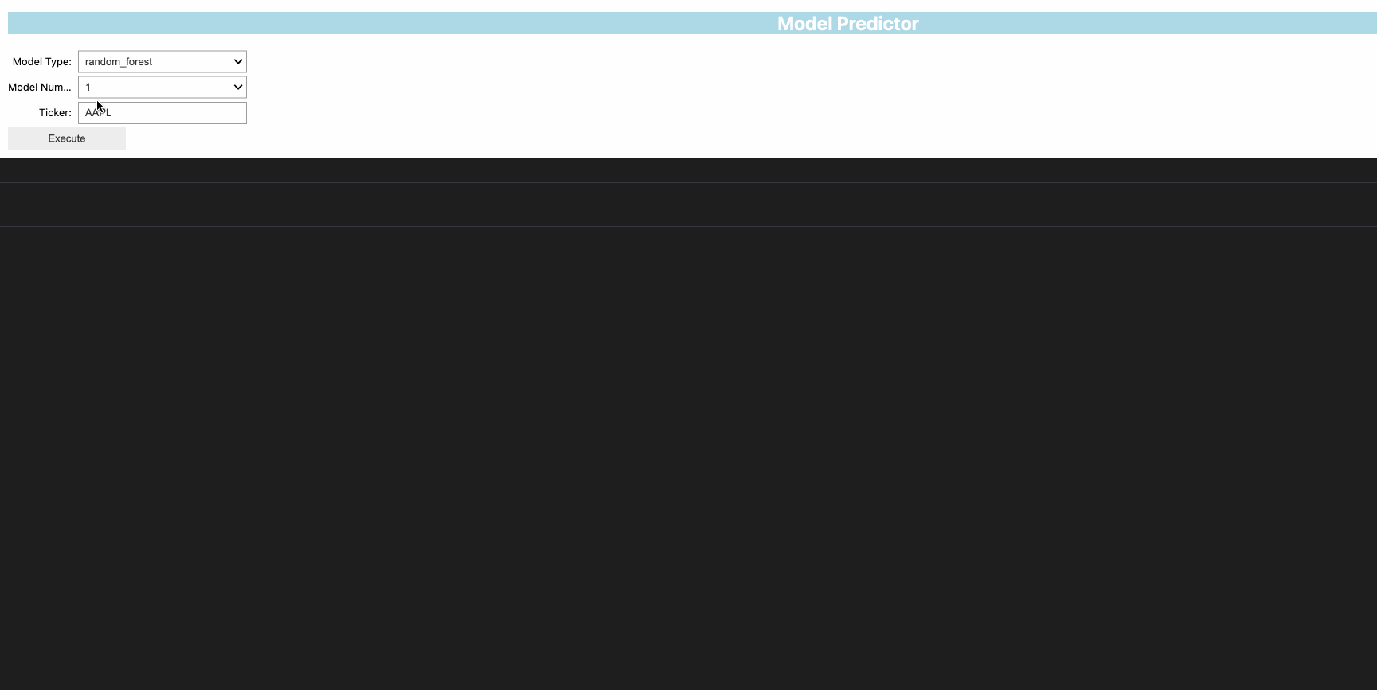
User Interface demo:

Slide 20

Conclusions
Human oversite is always important
By leveraging advanced machine learning techniques and meticulous data preprocessing, the Random Forest model provides a reliable approach to forecast credit ratings.
This model can assist financial institutions and analysts in making informed decisions and effectively managing credit risk.

Slide 21
References
https://www.investopedia.com/
https://hbr.org/2002/03/making-sense-of-corporate-venture-capital
https://www.alphavantage.co/documentation/
https://stackoverflow.com/questions/36814100/pandas-to-numeric-for-multiple-columns
https://ipywidgets.readthedocs.io/en/latest/examples/Widget%20List.html
https://stockanalysis.com/pro/the-barbell-investor/
https://matplotlib.org/stable/gallery/color/named_colors.html
https://scikit-learn.org/stable/modules/generated/sklearn.ensemble.RandomForestClassifier.html
https://stackoverflow.com/questions/51921142/how-to-load-a-model-saved-in-joblib-file-from-google-cloud-storage-bucket
https://stackoverflow.com/questions/9622163/save-plot-to-image-file-instead-of-displaying-it
https://www.datacamp.com/tutorial/random-forests-classifier-python
https://keras.io/api/keras_tuner/hyperparameters/
https://pytorch.org/docs/stable/generated/torch.nn.ReLU6.html
https://seekingalpha.com/article/4679188-junk-bond-default-surge-continues-in-2024
https://pypi.org/project/imbalanced-learn/
https://www.youtube.com/watch?v=YUsx5ZNlYWc
https://www.youtube.com/watch?v=VtchVpoSdoQ&t=582s

Slide 22
References cont
# Curent ratio = totalCurentAssets / totalCurentLiabilities # Reference: https://www.investopedia.com/terms/c/currentratio.asp
# Long-term Debt / Capital = longTermDebt / (longTermDebt + totalShareholderEquity) # Reference: https://www.investopedia.com/terms/l/longtermdebt-capitalization.asp *Preferred stock doesn't appear to be available on Alpha Vantage and isn't always issued
# Debt/Equity Ratio = totalLiabilities / totalShareholderEquity # Reference: https://www.investopedia.com/terms/d/debtequityratio.asp
# Gross Margin = 100 × (totalRevenue - costofGoodsAndServicesSold) / totalRevenue # Reference: https://www.investopedia.com/terms/g/grossmargin.asp, https://www.omnicalculator.com/finance/margin#gross-margin-formula
# Operating Margin = operatingIncome / totalRevenue # Reference: https://www.investopedia.com/terms/o/operatingmargin.asp
# EBIT Margin: ((totalRevenue - costofGoodsAndServicesSold - operatingExpenses) / totalRevenue) * 100 # Reference: https://www.investopedia.com/terms/e/ebit.asp
# EBITDA Margin: (incomeBeforeTax + depreciationAndAmortization) / totalRevenue # Reference: https://www.investopedia.com/terms/e/ebitda-margin.asp
# Pre-Tax Profit Margin: (incomeBeforeTax / totalRevenue) * 100 # Reference: https://www.investopedia.com/terms/p/pretax-margin.asp
# Net Profit Margin: (netIncome / totalRevenue) * 100 # Reference: https://www.investopedia.com/terms/n/net_margin.asp
# Asset Turnover Ratio: totalRevenue / ((totalAssets + totalAssetsPrevious) / 2) # totalAssetsPrevious: totalAssets(from preYear) [1] = previous year

Slide 23
References cont
# ROE - Return On Equity: netIncome / ((totalShareholderEquity(curYear) + totalShareholderEquity(preYear)) / 2) # Reference: https://www.investopedia.com/terms/r/returnonequity.asp
# Return On Tangible Equity: netIncome / (avgShareholderEquity - intangibleAssets) # Reference: https://www.wallstreetprep.com/knowledge/return-on-tangible-equity-rote/
# ROA - Return On Assets: netIncome / totalAssets # Reference: https://www.investopedia.com/terms/r/returnonassets.asp
# ROI - Return On Investment: (netIncome / ((totalShareholderEquity(curYear) + totalShareholderEquity(preYear)) / 2)) * 100 # Reference: https://www.wallstreetprep.com/knowledge/return-on-equity-roe/, https://www.investopedia.com/terms/r/returnoninvestment.asp
# Operating Cash Flow Per Share: operatingCashflow / commonStockSharesOutstanding #Reference: https://www.investopedia.com/terms/c/cashflowpershare.asp, https://www.wallstreetprep.com/knowledge/cash-flow-per-share/
# Free Cash Flow Per Share: (operatingCashflow - capitalExpenditures) / commonStockSharesOutstanding # Reference: https://www.investopedia.com/terms/f/freecashflowpershare.asp
https://github.com/mwaskom/seaborn/issues/3478
"Practical Statistics for Data Scientists" by Peter Bruce, Andrew Bruce, & Peter Gedeck - O'Reilly Press
"Designing Machine Learning Systems" by Chip Huyen - O'Reilly Press

Slide 24


Thank you. Questions?

